Slide 1


CROPCRAFTERS
Novelty of our project

Slide 2

Dual Attention
DANet works by embedding dual attention methods into its design, greatly improving its capacity to acquire spatial context and feature representation. While spatial attention modifies feature responses across spatial placements, making it easier to record complex connections, channel attention fine-tunes feature responses across different channels to highlight important qualities. The synergistic combination of these attention processes dramatically increases DANet's capacity to absorb complex information, leading to notable gains in semantic segmentation accuracy. Additionally, DANet uses the network's deeper and coarser layers of semantic information to combine it with shallower and finer levels of appearance information.

Slide 3
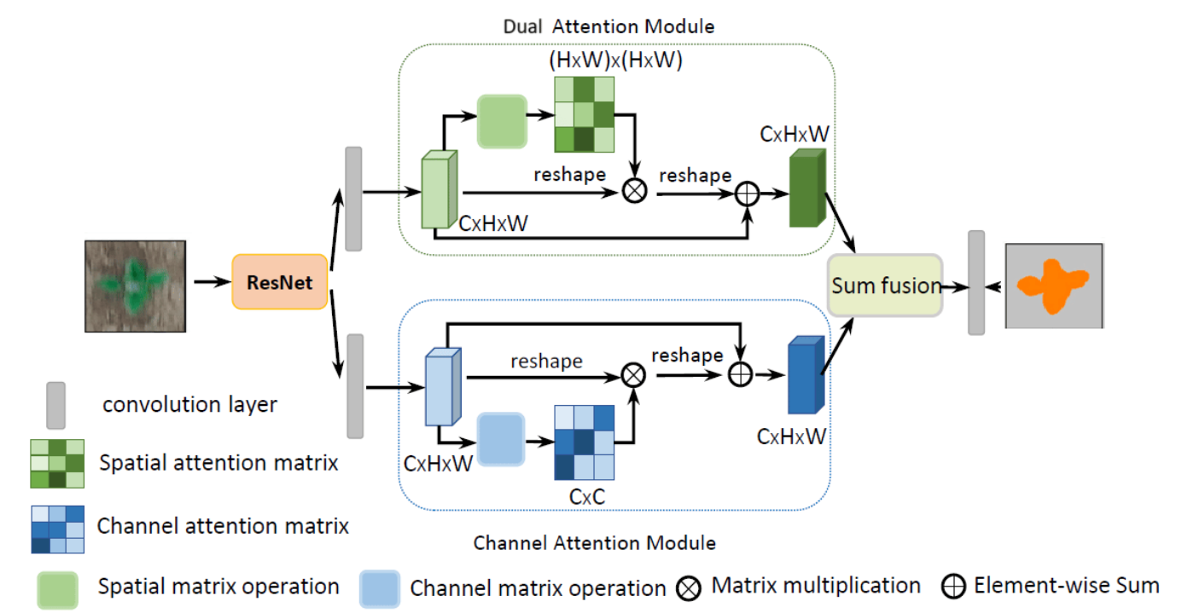

Slide 4

ESRGAN
ESRGAN on the hand is built upon the concept of adversarial networks (GANs). It consists of a generator network and a discriminator network. The main objective of the discriminator network is to distinguish high resolution images, from those generated by the generator while the generator learns to produce high resolution images. ESRGAN employs techniques and architectural designs to enhance the quality of its high resolution image output. These techniques often involve loss functions and deep residual networks, which consistently deliver results in super resolution challenges.

Slide 5
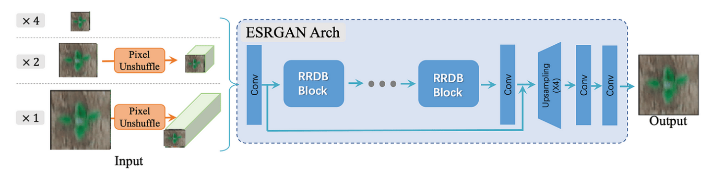

Slide 6
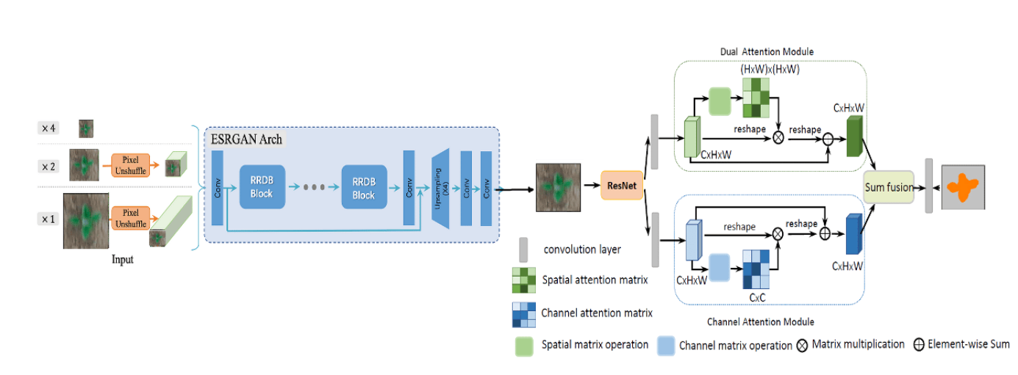
COMBINED ARCHITECTURE

Slide 7
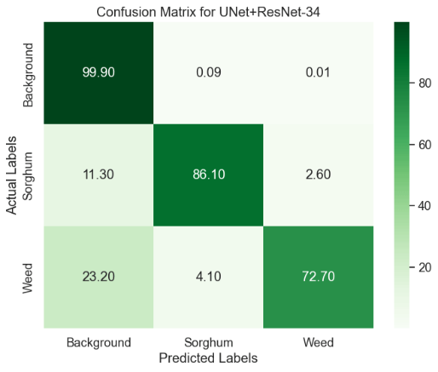
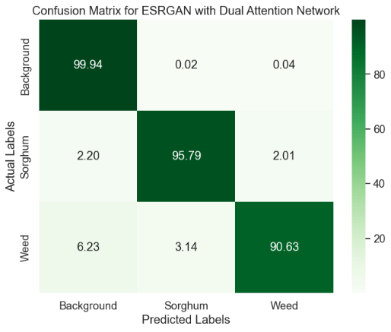
EFFICIENCY

